Slide 1
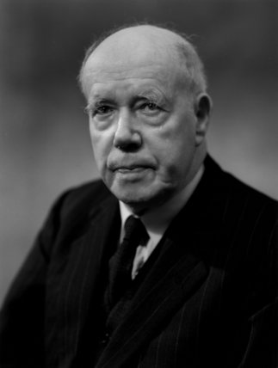
W. D. Ross’ Theory of Prima Facie Duties
http://www.npgprints.com/image/321039/bassano-ltd-sir-william-david-ross

Slide 2
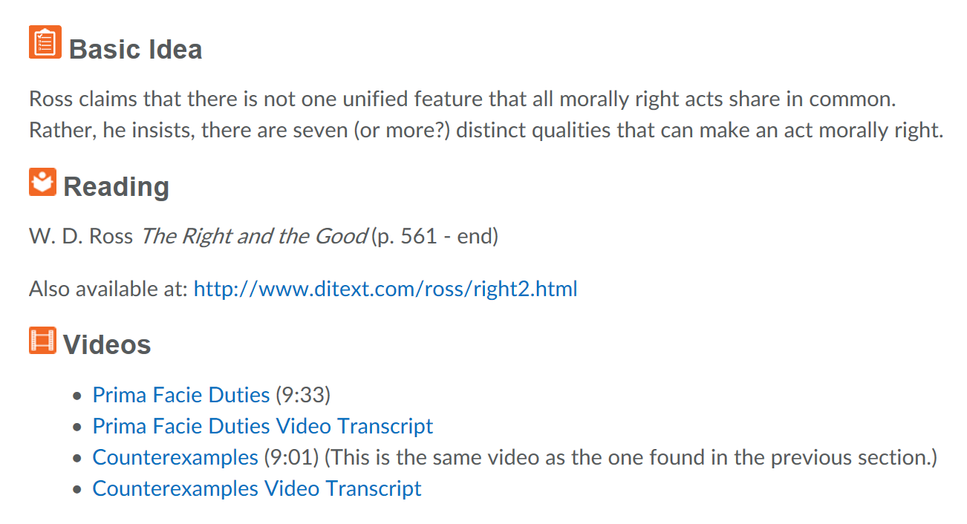

Slide 3
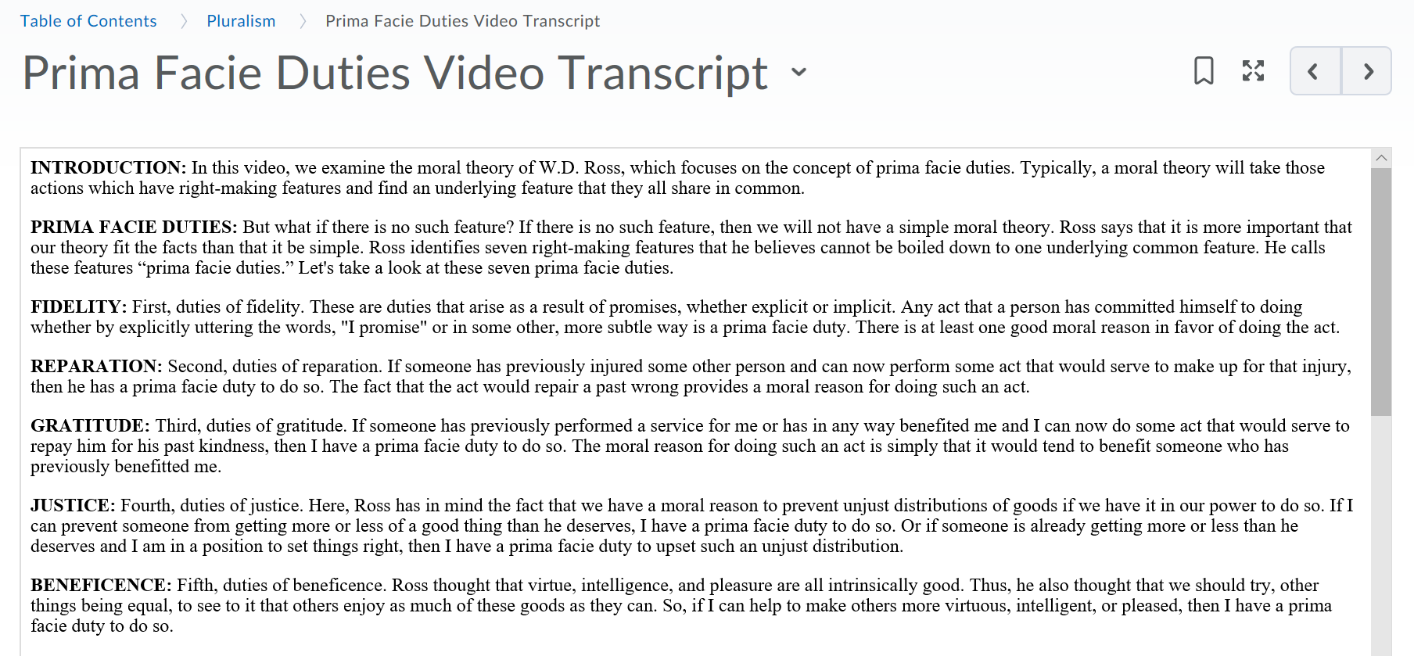

Slide 4


Slide 5
W. D. Ross’ Theory of Prima Facie Duties
http://www.npgprints.com/image/321039/bassano-ltd-sir-william-david-ross

Slide 6
Sir William David Ross: 1877-1971
http://www.npgprints.com/image/321039/bassano-ltd-sir-william-david-ross

Slide 7
W. D. Ross: Ethical Intuitionist
http://www.npgprints.com/image/321039/bassano-ltd-sir-william-david-ross

Slide 8
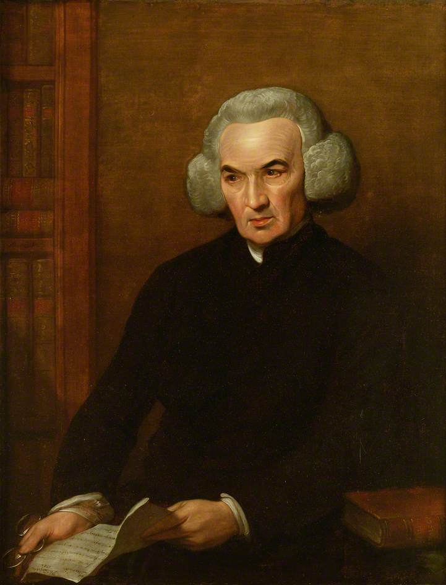
“… INTUITION; by which I mean the mind’s survey of its own ideas, and the relations between them, and the notice it takes of what is or is not true and false, consistent and inconsistent, possible and impossible in the nature of things. It is to this… we owe our beliefs of self-evident truths.” –Richard Price A Review of the Principal Questions in Morals (1758)
Portrait of Richard Price (1784) by Benjamin West

Slide 9
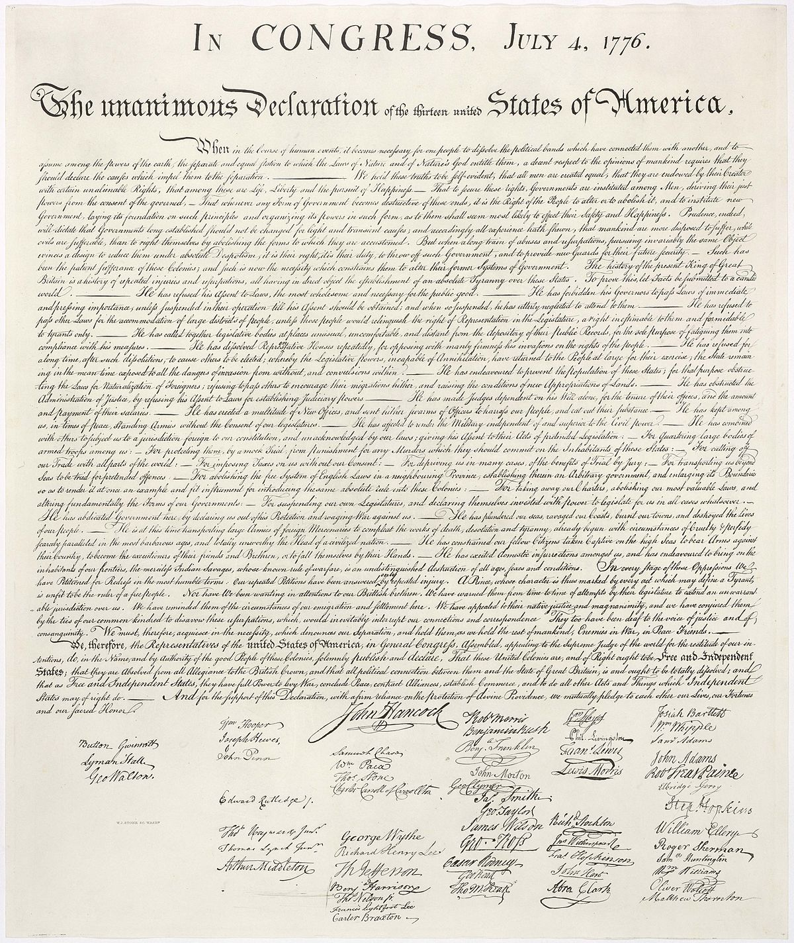
“We hold these truths to be self-evident, that all men are created equal, that they are endowed by their Creator with certain unalienable Rights, that among these are Life, Liberty and the pursuit of Happiness.”
https://en.wikipedia.org/wiki/United_States_Declaration_of_Independence

Slide 10
“We hold these truths to be self-evident, that all men are created equal, that they are endowed by their Creator with certain unalienable Rights, that among these are Life, Liberty and the pursuit of Happiness.”
https://en.wikipedia.org/wiki/United_States_Declaration_of_Independence

Slide 11
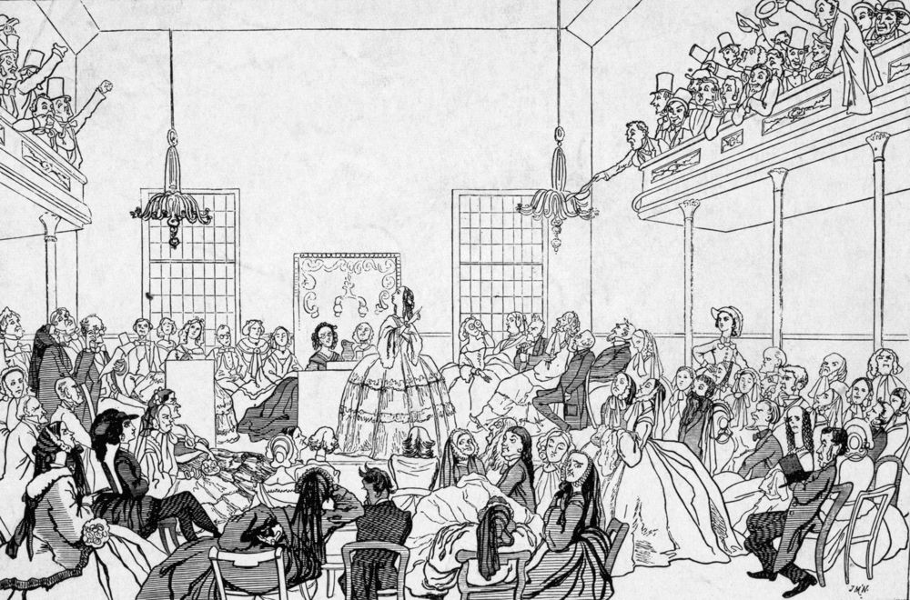
"All men and women are created equal."
–motto of Seneca Falls Convention (1848)
https://www.biography.com/news/seneca-falls-convention-leaders

Slide 12

he
she
they
“All humans are created equal.”
Is that self-evident?
boumenjapet©123rf.com

Slide 13
Either humankind is created or there is a plausible alternative explanation for the existence of humankind.
It is not the case that there is a plausible alternative explanation for the existence of humankind.
Therefore, humankind is created.

Slide 14

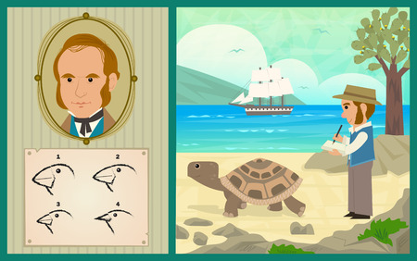
Either humankind is created or there is a plausible alternative explanation for the existence of humankind.
It is not the case that there is a plausible alternative explanation for the existence of humankind.
Therefore, humankind is created.
bilhagolan©123rf.com

Slide 15

Self-evident Claims
not derived from other claims
If P, then Q
P
Therefore, Q

Slide 16
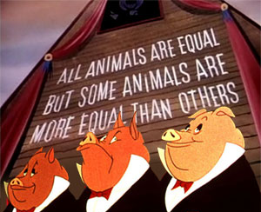
Is the second claim self-evident? Why or why not?
Animal Farm (1954)

Slide 17

Self-evident Claims
not derived from other claims
not perceived as false by those
who really understand them
france68©123rf.com

Slide 18
Self-evident Claims
not derived from other claims
not perceived as false by those who really understand them
instead, perceived as true by those who really understand them
Example 1: No one can be more equal than another.
Example 2: The fact that one has made a promise to do an action
counts as a moral reason for doing that action.

Slide 19
Why think that some claims are self-evident?

Slide 20
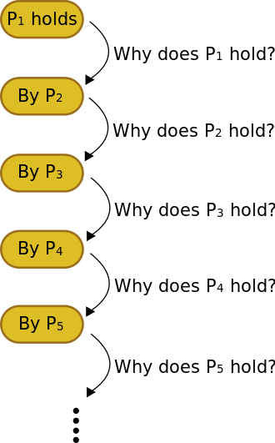
Why think that some claims are self-evident?

Slide 21
Self-evident claims seem to be needed to avoid an infinite regress of justification.
https://en.wikipedia.org/wiki/Infinite_regress

Slide 22
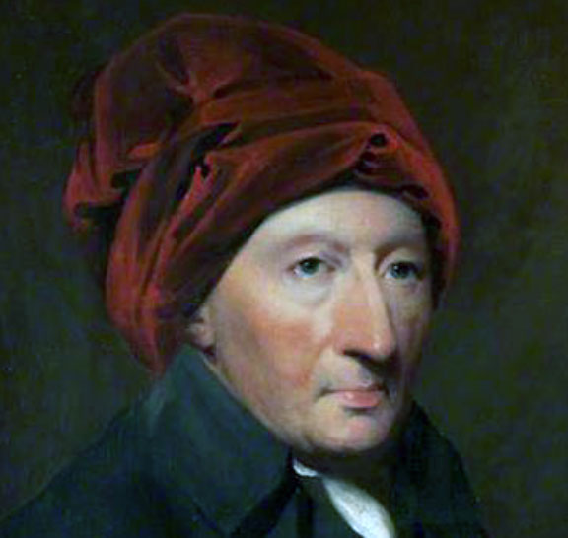
“All reasoning must be grounded on first principles. This holds in moral reasoning, as in all other kinds... But, without such principles, we can no more establish any conclusions in morals, than we can build a castle in the air, without any foundation.” –Thomas Reid Essays on the Active Powers of the Human Mind (1788)
http://www.iep.utm.edu/reid-act/

Slide 23

Early Intuitionists vs. Sentimentalists
jpgon©123rf.com

Slide 24
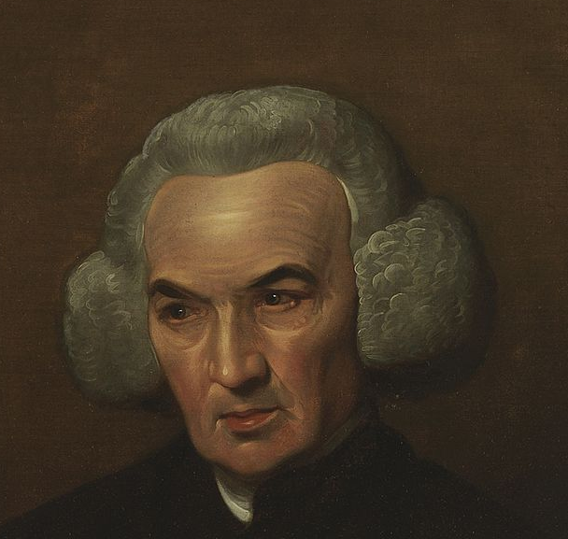
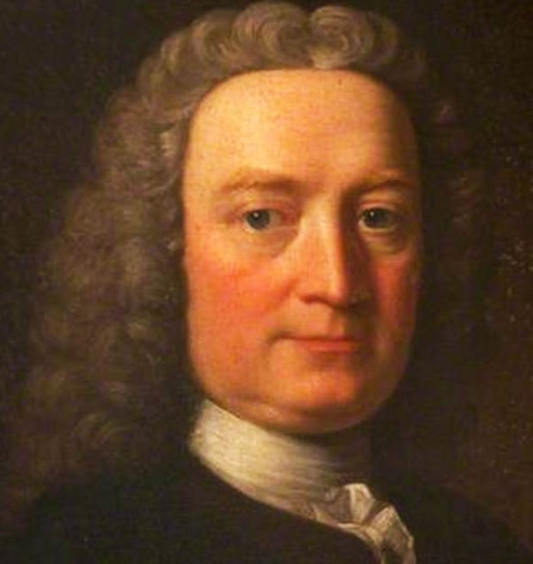
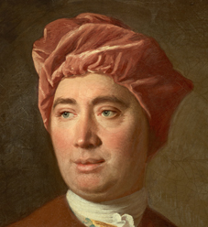
Early Intuitionists vs. Sentimentalists
Richard Price
Thomas Reid
Francis Hutcheson
David Hume
jpgon©123rf.com

Slide 25
Early Intuitionists vs. Sentimentalists
“Take any action allowed to be vicious; willful murder, for instance. Examine it in all lights, and… you only find certain passions, motives, volitions, and thoughts…. The vice entirely escapes you… till you turn your reflection into your own breast and find a sentiment of disapprobation….”
– David Hume A Treatise of Human Nature (1739-1740)
jpgon©123rf.com

Slide 26
Early Intuitionists vs. Sentimentalists
“… our ideas of right and wrong are simple ideas, and must therefore be ascribed to some power of immediate perception of the mind…. It is true, some impressions of pleasure or pain, satisfaction or disgust, generally attend our perceptions of virtue and vice. But these are merely their effects and concomitants, and not perceptions themselves, which ought no more be confounded with them, than a particular truth (like that for which Pythagoras offered a Hecatomb) ought to be confounded with the pleasure that may attend the discovery of it.”
– Richard Price A Review of the Principal Questions in Morals (1758)
jpgon©123rf.com

Slide 27
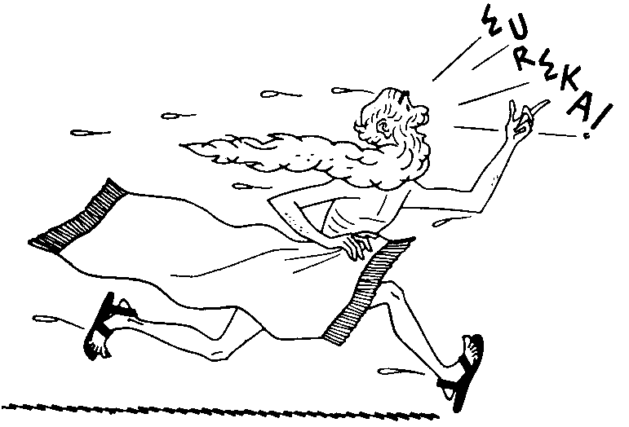
https://hdnh.es/arquimedes-biografia-vida-historia/arquimedes-eureka/

Slide 28
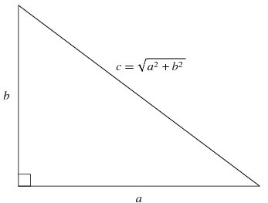

x100
https://hdnh.es/arquimedes-biografia-vida-historia/arquimedes-eureka/

Slide 29
Early Intuitionists vs. Sentimentalists
jpgon©123rf.com

Slide 30
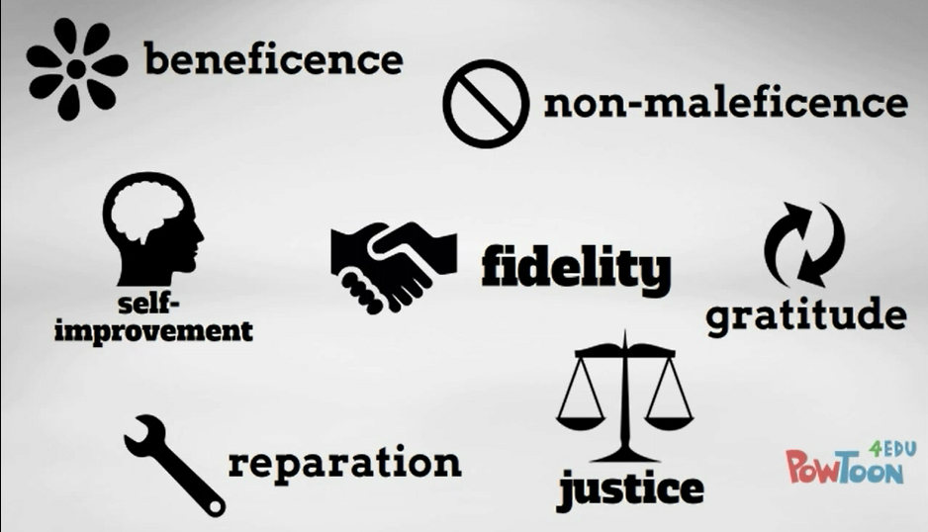
Moral Pluralism

Slide 31
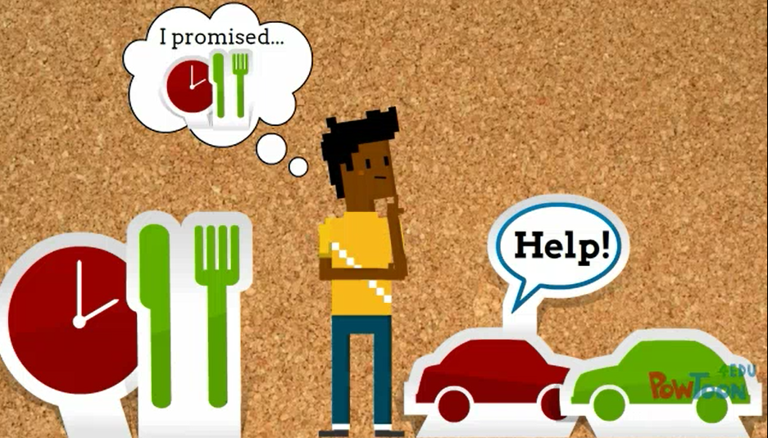

Slide 32
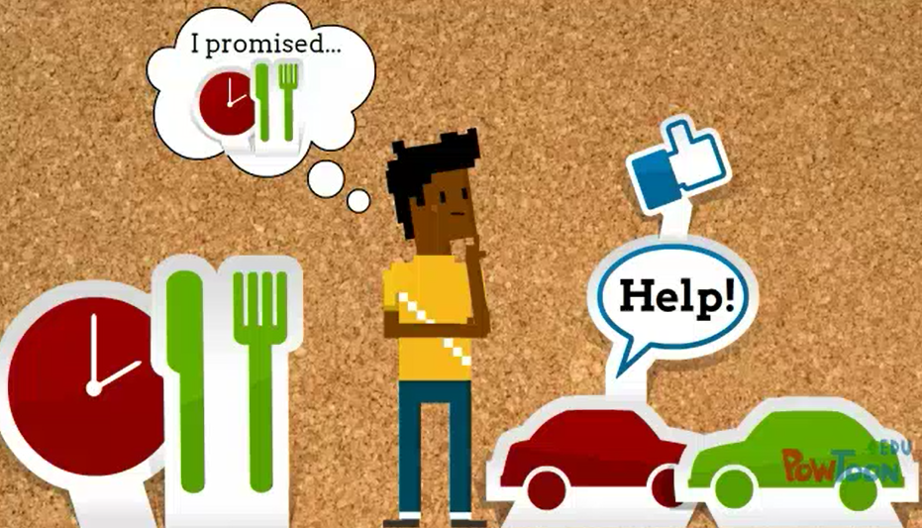

Slide 33

“An Unconnected Heap of Duties?”
–David McNaughton (1996)
anikasalsera©123rf.com

Slide 34
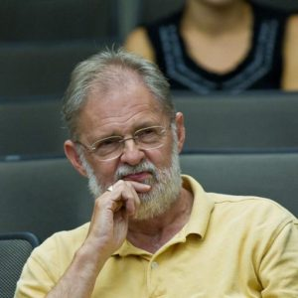
“Since there is no structure to this list, there seems to be no explanation of why some items are on the list and not others, and therefore no room for rational debate in the event of disagreement about what should be included.” –David McNaughton (1996)
https://david-mcnaughton.com/photos/

Slide 35

“[In addition to] being possible beneficiaries of my action… [others] may also stand to me in relation of promisee to promiser, of creditor to debtor, of wife to husband, of child to parent, of friend to friend, of fellow countryman to fellow countryman and the like; and each of these relations is the foundation of a prima facie duty.” –W. D. Ross The Right and the Good (1930)
http://hersecondinnings.com/7-tips-to-managing-different-relationships-of-life/

Slide 36
“[In addition to] being possible beneficiaries of my action… [others] may also stand to me in relation of promisee to promiser, of creditor to debtor, of wife to husband, of child to parent, of friend to friend, of fellow countryman to fellow countryman and the like; and each of these relations is the foundation of a prima facie duty.” –W. D. Ross The Right and the Good (1930)
http://hersecondinnings.com/7-tips-to-managing-different-relationships-of-life/

Slide 37

rido©123rf.com

Slide 38
“[In addition to] being possible beneficiaries of my action… [others] may also stand to me in relation of promisee to promiser, of creditor to debtor, of wife to husband, of child to parent, of friend to friend, of fellow countryman to fellow countryman and the like; and each of these relations is the foundation of a prima facie duty.” –W. D. Ross The Right and the Good (1930)
http://hersecondinnings.com/7-tips-to-managing-different-relationships-of-life/

Slide 39

“Without feminist insistence on the relevance for morality of the experience of mothering, [the context of the household] is largely ignored by moral theorists. And yet, from a gender-neutral point of view, how can this vast and fundamental domain of human experience possibly be imagined to lie ‘outside morality’?”
-Virginia Held (1990)
https://ethicsofcare.org/author/webteam/page/12/

Slide 40

elenathewise©123rf.com

Slide 41
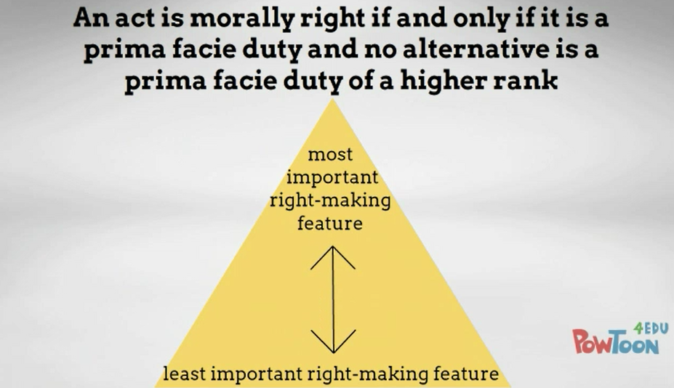
.

Slide 42
.
Which prima facie duty type would you rank at the top or the bottom of Ross’ list?

Slide 43
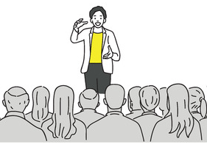

“Say, for example, that in order to repay a friend for helping you with a difficult assignment, you plan to buy him a drink at a local bar. However, at the same time you planned to take him a presenter will be giving a rare talk on a subject you enjoy. Since you haven’t told the friend yet, you are more obligated to go to the talk…. Now, imagine that instead of a homework assignment, this friend instead helped you by donating a vital organ that you badly needed. And, in addition, he will be moving away soon. In this case, you are more morally obligated to present him with gratitude for making such a large sacrifice.” –Brad Campbell
jjesadaphorn©123rf.com
yupiramos©123rf.com

Slide 44
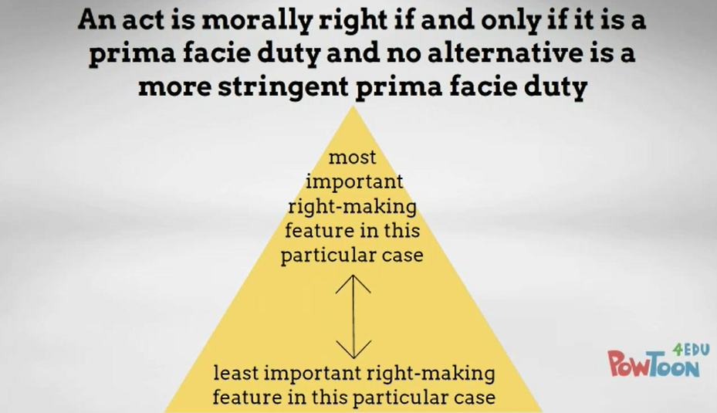
.

Slide 45
What is the deficiency of Ross’ theory if there is no fixed ranking of prima facie duty types?

Slide 46
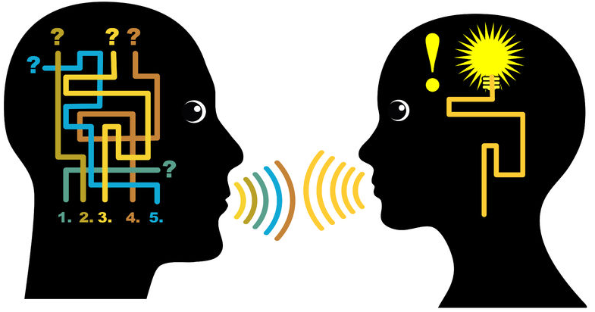
What is the deficiency of Ross’ theory if there is no fixed ranking of prima facie duty types?
sangoiri©123rf.com

Slide 47
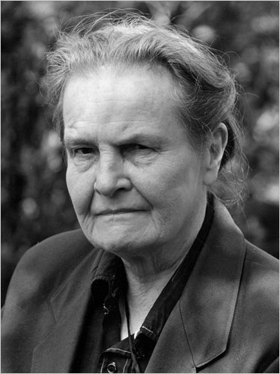
G. E. M. Anscombe
“Modern Moral Philosophy” (1958)
http://www.nytimes.com/2011/01/08/us/08beliefs.html

Slide 48

Human Wellbeing and the Good Life: Aristotle (Chris Surprenant)

Slide 49

Technical Manual Model: “Ethical theories, in the tradition in which they have developed in the twentieth century, have raised a certain expectation about ethical theory: that it will apply to everyone in the same way, and that it will do so by telling people what to do in a fairly specific manner.”
–Julia Annas (2004)
http://www.happinessandwellbeing.org/julia-annas/

Slide 50

vadimgozhda©123rf.com

Slide 51
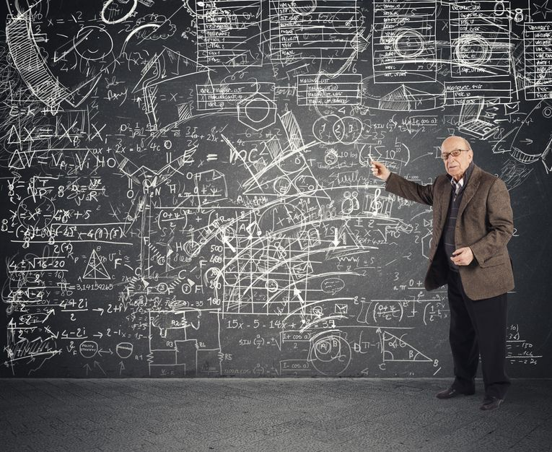
alphaspirit©123rf.com

Slide 52


Slide 53
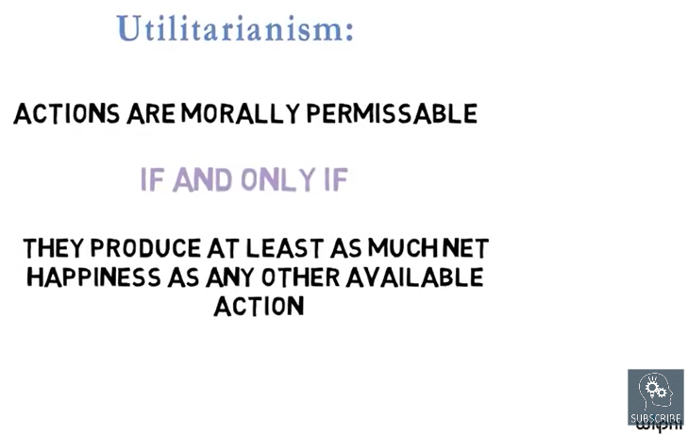

Slide 54
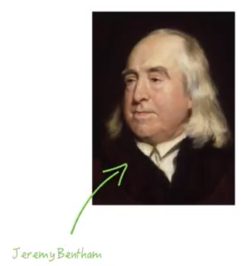

Slide 55
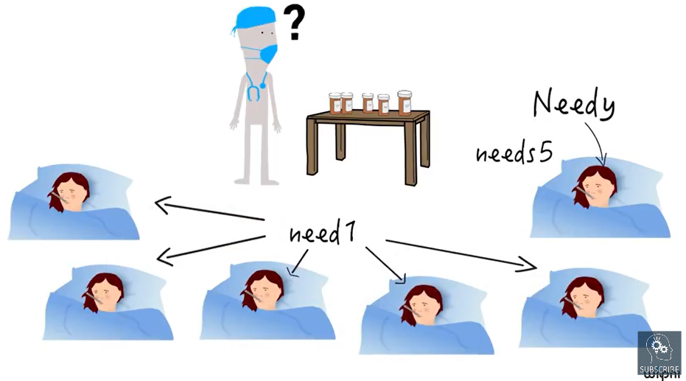

Slide 56
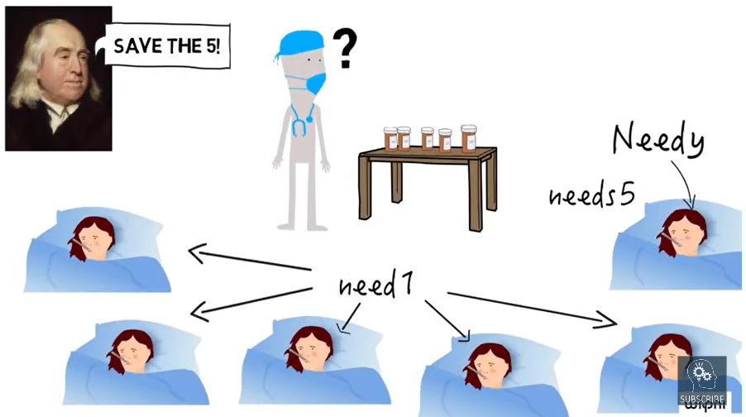

Slide 57
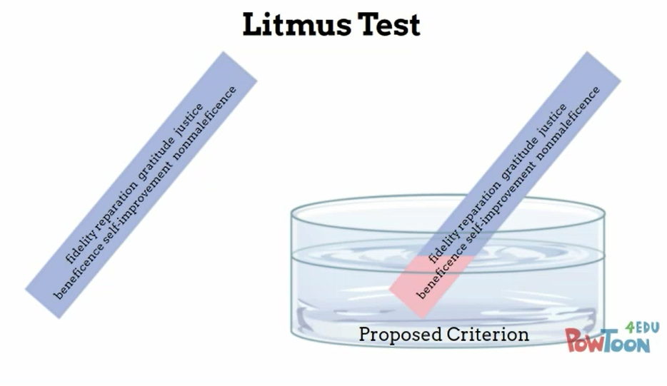

Slide 58
Describe your own counterexample to Utilitarianism involving punishment.

Slide 59
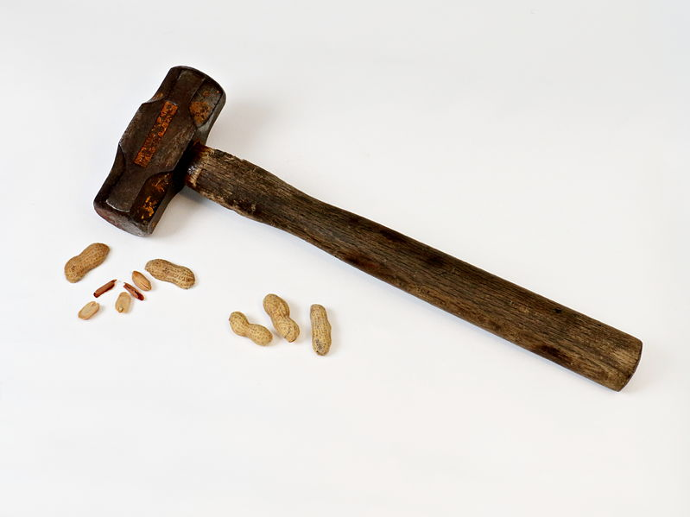
Describe your own counterexample to Utilitarianism involving punishment.
rasilja©123rf.com

Slide 60
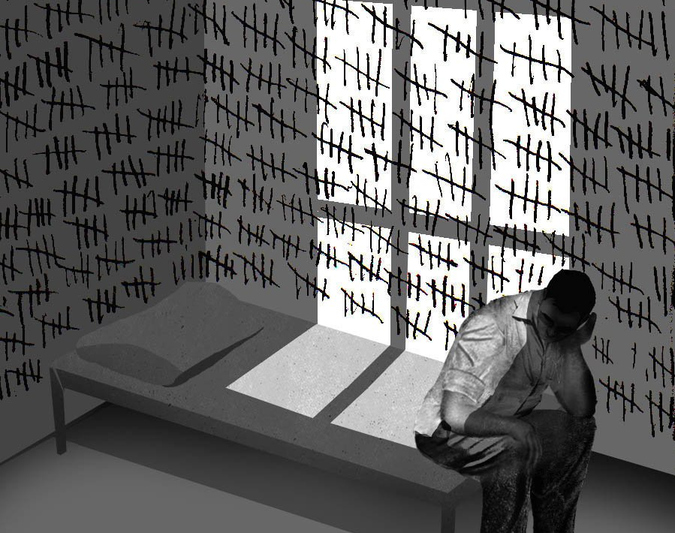
More than Deserved
http://www.nytimes.com/2012/12/17/opinion/life-sentences-for-low-level-crimes.html

Slide 61
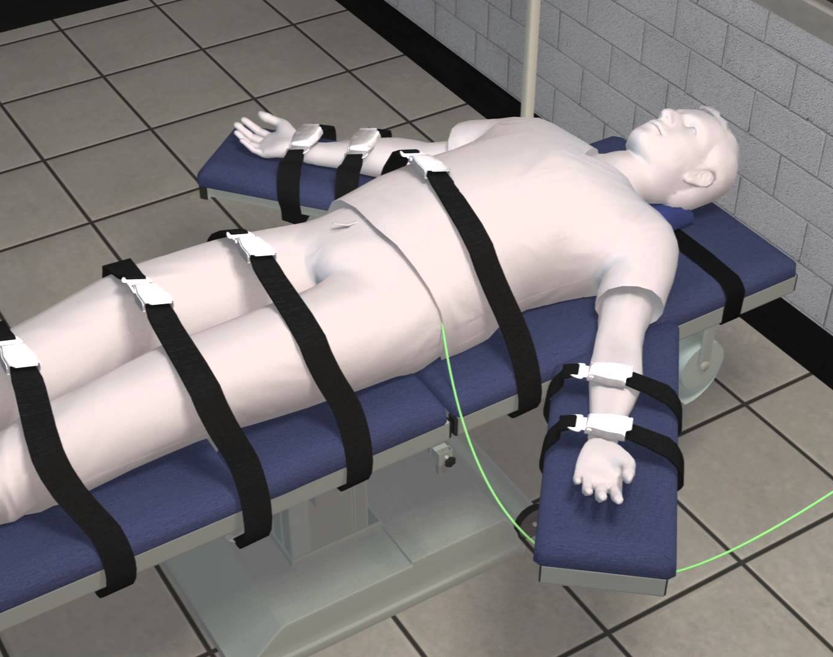

“Let’s say a gang member kills a high-ranking officer of a rival gang. This rival gang is angry and wants to retaliate…. However, the police know who committed the murder, and they know that if the gang finds out there will be a full on gang war and many innocent lives would be lost. Utilitarianism says that in order to maximize the good the police should frame an innocent man with no ties to either gang.” –Elyse Castles
https://www.youtube.com/watch?v=j5IwxnLFwv0

Slide 62
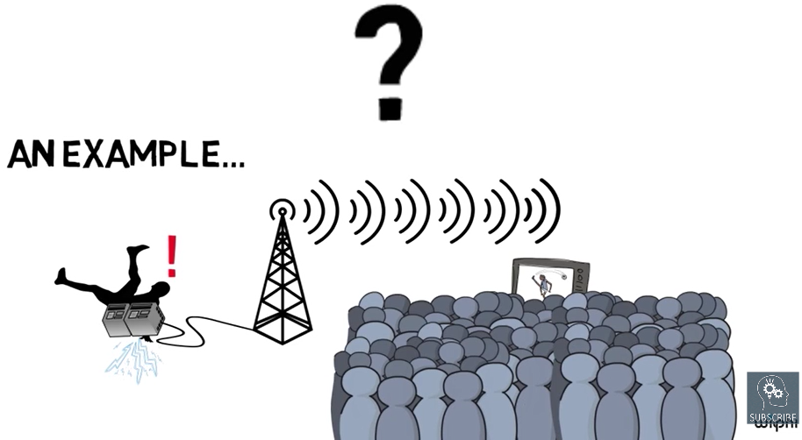

Slide 63


